Slide 1
8th Grade Science
Chapter 11-1
Frame of Reference and Relative Motion

Slide 2
Learning Objectives
I can describe a frame of reference
I can explain relative motion
I can describe a reference point

Slide 3
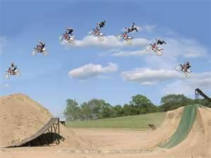
MOTION
Motion is defined as the change of position over time.
A change in position is evidence that motion
has happened.

Slide 4
3 Things you need to know to describe motion
State direction the object is moving
How fast the object is moving
Location at a certain time

Slide 5
Frame of Reference/Reference Point
A system of objects that are not moving respect to one another.
  A reference point is a place or object used for comparison to determine if something is in motion.
    An object is in motion if it changes position relative to a reference point.
Objects that we call stationary—such as a tree, a sign, or a building—make good reference points.

Slide 6
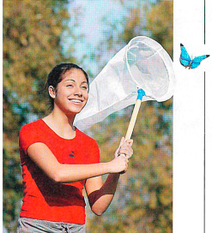
Frame of Reference
Identify a good frame of reference to use
when describing the butterfly’s motion.
Trees

Slide 7
Relative Motion
Is movement in relation to a frame of reference or reference point.
To describe motion (Relative) accurately and completely, a frame of reference is necessary.

Slide 8
Train Example Relative Motion
Explain using the term relative motion and frame of reference how people can appear to be moving or not moving in the train example.
As the train moves past a platform, people standing on the platform will see those on the train speeding by.
When the people on the train look at one another, they don’t seem to be moving at all.

Slide 9
Train Example Relative Motion
When you sit on a train and look out the window, a treetop may help you see how fast you are moving relative to the ground.
If you get up and walk toward the rear of the train, looking at a seat or the floor shows you how fast you are walking relative to the train.

Slide 10
Relative Motion
How do you know if you are moving?
It’s all relative to your reference point (Frame of Reference).
If your chair is the reference point, then all of you are NOT moving, BUT….
…suppose you choose the sun as a reference point?
If you compare yourself to the sun, then you are moving quite rapidly. This is because you, and your chair are on Earth, which moves around the sun.
Earth moves about 30 kilometers every second.

Slide 11
Reference Frame
Is the speed of the ball different relative to the pitcher, the truck driver, and the jet pilot? Why or why not?

Slide 12
Moving Reference Point
  You probably know what happens if your reference point is moving.
  Have you ever been in a car in a parking lot and the car next to you backs out?
  It feels like you are moving forwards, but, then you realize that it is the other car that is moving???
  Your car seemed to move forwards because you were using the other car as a reference point.

Slide 13
Relative Motion
Relative motion depends on your frame of reference. Depending on your frame of reference (what you are using as your frame of reference) will determine if it seems you are moving or not relatively speaking.
Choosing a meaningful frame of reference allows you to describe motion in a clear and relevant matter.

Slide 14
Big Ideas
To describe motion (Relative) accurately and completely, a frame of reference is necessary.
A change in position is evidence that motion has happened.
A reference point is a place or object used for comparison to determine if something is in motion.

